Slide 1

T-DEV-701 – Dev OPS
Kick-off

Slide 2

Developers’ typical issue 1

Slide 3

Developers’ typical issue 2

Slide 4

Developers’ typical issue 3

Slide 5

Developers’ repetitive tasks
Compiling the code
Testing the code
Checking the code quality
Deploying the code
Versioning the code
Doing it again...
and again...
and again!!

Slide 6

The solution to all these annoyances
Adopting the Dev Ops philosophy and best practices has countless benefits.

Slide 7

Dev Ops main challenges
Organisation
Collaboration
Compliance
Performance
Stability
Availability
Flexibility

Slide 8

Dev Ops main benefits
Improved quality and automation
Faster, better, stronger product delivery
Easier maintainability and issue resolution
Greater flexibility, scalability and availability
Reduced complexity, cycle time, human labour and costs
More time + freedom for creative and innovative tasks

Slide 9

Have you ever played Satisfactory?
Automation saves lot of time and provides a great deal of satisfaction.

Slide 10
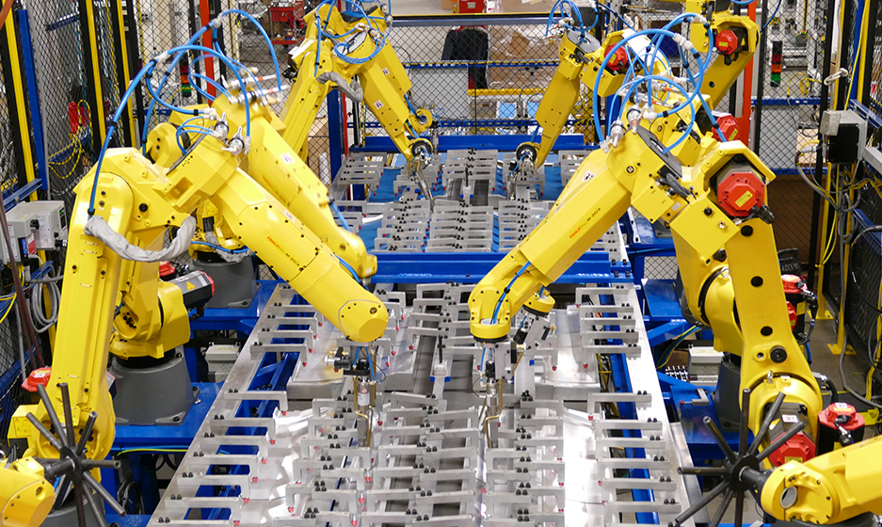
Main benefits of automation
Avoid oversights.
Increase productivity.
Reduce costs & cycle time.
Improve quality & robustness.
Free up coders to focus elsewhere.

Slide 11
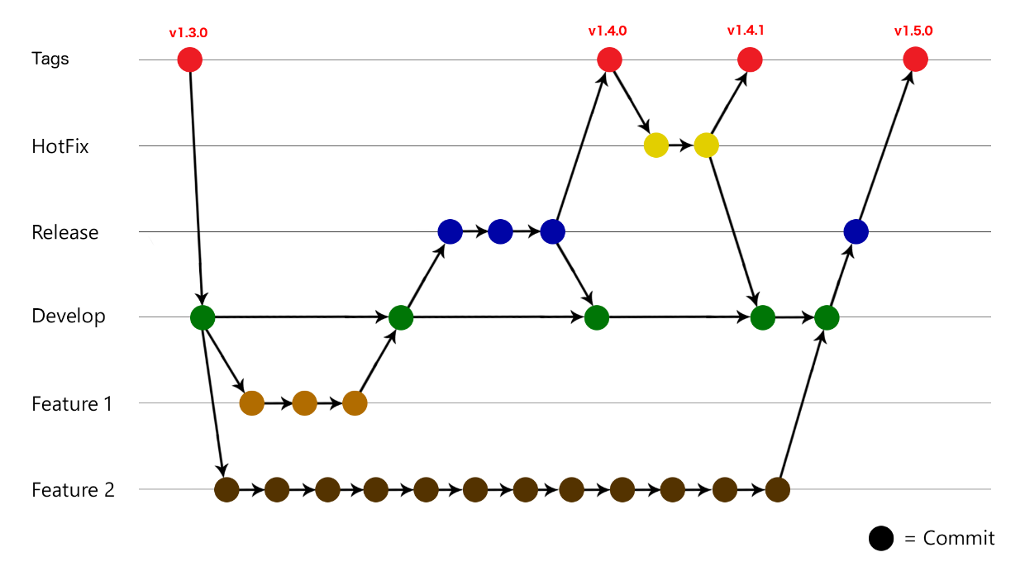
How a proper git flow should look like
main branch is always deployable (using tags)
QA testing is done on feature-branch (before merging into main)
merging to main should trigger actions (such as deployment)

Slide 12
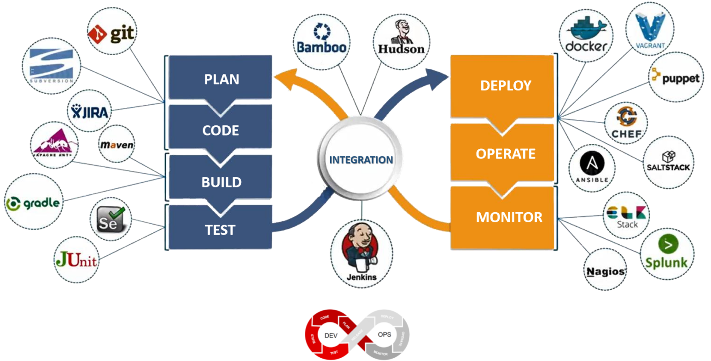
Dev Ops common tools

Slide 13

Stuff to watch and dig
DevOps in 5 minutes
The ING Bank improved its time to market from 13 weeks to less than 1
AAA Automated testing…for AAA games, by a Games developer advocate at Google
Game development with Dori Exterman, CTO at IncrediBuild
The Secrets to Agility at Tesla | Elon's Master Plan to Infinity
How software lifecycle integration and DevOps are transforming car development

